Slide 1
ESGF Installer Python Conversion
Task |  | R&D Area
1.1 |  | Data Management
1.2 |  | User Interface and Search
1.3 |  | Hardware & Network
1.4 |  | Data Transfer
1.5 |  | Installation (Containerized)
1.6 |  | Authentication & Authorization
1.7 |  | Federation
1.8 |  | Quality Control & Assurance
1.9 |  | Replication
1.10 |  | Distributed Search
1.11 |  | Metrics
1.12 |  | User Notification
1.13 |  | Long-tail Publication
1.14 |  | Distributed Computation
1.15 |  | Data Citation
2.1 |  | Provenance Capture
2.2 |  | Workflow
2.3 |  | Dynamic Resources
2.4 |  | In situ Analysis
2.5 |  | Machine Learning
2.6 |  | UQ
2.7 |  | Analytical Modeling
2.8 |  | Mobile Apps
Current capability status:
 | Usable
 | Prototype
 | Research activity
William Hill
Lawrence Livermore National Laboratory
2017 Triennial Project Review, Potomac, MD
June 8 – 9, 2017

Slide 2
Background
The Installer is software, composed of a series of individual installation scripts, that installs the complex ESGF software stack at worldwide leading institutions
Without the Installer, the ESGF software stack would be next to impossible to install, thus saving the installer valuable time and resources
The Installer is used by ESGF node administrators at Modeling centers and Data centers
Notes:
Esg-node is 6500+ LOC
Dev horror story: two typos (missing quotes) cost me around two hours of development time
LIU - Sweden
IPSL – France
CEDA - UK

Slide 3
Background - Limitations
The ESGF Installer is currently written as a collection of large, monolithic Bash scripts
The scripts lack any discernable structure and Bash’s arcane, symbol-based syntax makes maintenance difficult
There’s virtually no automated testing implemented for the scripts.

Slide 4
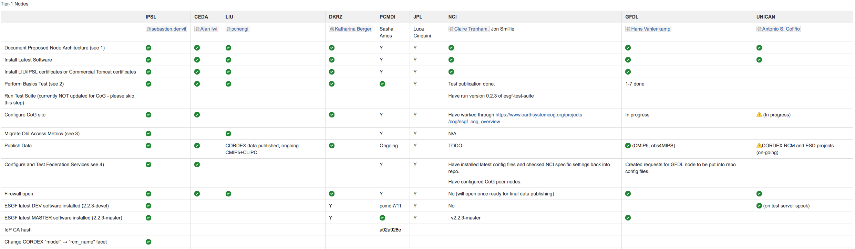
List of node administrators for Tier 1 sites
Notes:
Shows our worldwide collaboration and their compliance

Slide 5


Supported hardware and operating systems
The ESGF software stack currently runs on any hardware server that supports Red Hat® Enterprise Linux (RHEL) 6.x or CentOS 6.x operating systems
At LLNL, we have several ESGF nodes running on 16-Quad Core Dell computers
The ESGF Software stack is written primarily in Python, Java, and Bash
Notes:
RHEL and CentOS are “officially” supported.

Slide 6
ESGF Installer Roadmap
Switch to RPM-based installation for Tomcat component
Develop new Python-based script for ESGF Installation
Dockerize data node stack
Implement continuous integration using existing continuous build workflow and infrastructure

Slide 7
ESGF Installer Repository
The ESGF Installer repo is hosted on GitHub and can be found at https://github.com/ESGF/esgf-installer
There are several dependencies for the Installer that are fetched from pip, conda, yum, and other GitHub repositories
The ESGF Installation Working Team Release notes and roadmaps can be found at https://acme-climate.atlassian.net/wiki/pages/viewpage.action?pageId=3998241
Notes:
Roadmap picture source [https://esgf.llnl.gov/media/pdf/ESGF-Implementation-Plan-V1.0.pdf page 31]

Slide 8
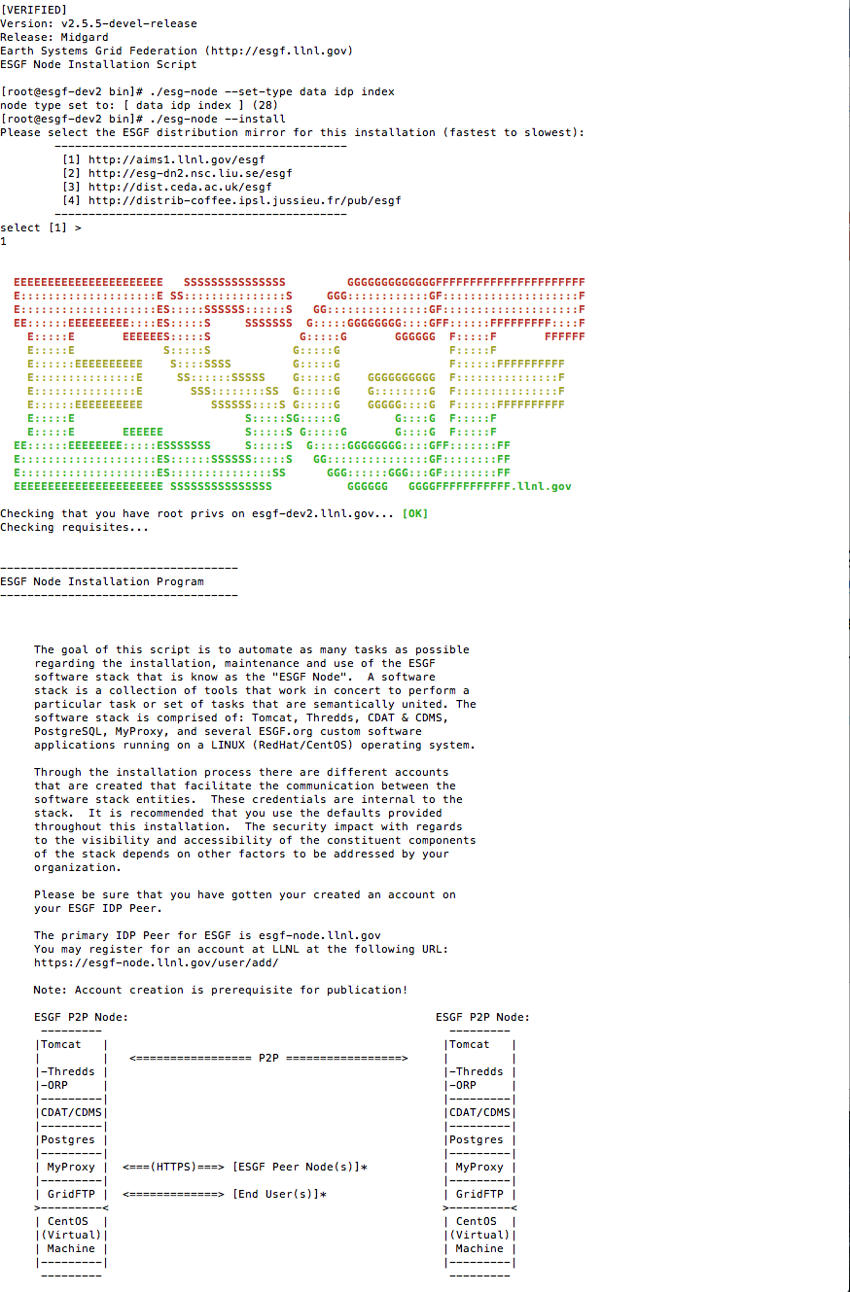
ESGF Installation Process
A step-by-step guide for installing the ESGF software stack can be found at https://github.com/ESGF/esgf-installer/wiki
The installer is a command line interface that asks the user for configuration input throughout the installation process
There is also an “autoinstaller” that allows the user to give all the configuration input upfront before starting the installation process
The installer can be ran to completion in about 45 minutes for an experienced user
Notes:
The installer provides reasonable default input for most options
Installation has taken a couple of days according to Peggy Li
Issues during installation (some comments from Peggy Li):
Not obvious that you should shut down the pipe when error occurs when using autoinstaller
Not obvious where help could be found or where logging output was written
Not obvious what some components are that get installed
Not obvious what some configuration options do
Error message not really helpful

Slide 9
ESGF Release Process
Create feature list
Active development
Cut development release
Code freeze
Test federation
Security scans
Production

Slide 10
ESGF Release Process
The release process for new versions of the ESGF Installer involves deploying the compiled binary files to several redundant distribution mirrors
There are development releases cut for the Installation Working Team to test on their respective nodes before deploying the release to production
Each release and associated subcomponent is versioned
The release candidate is deployed to the test federation after the feature freeze goes into effect
Notes:
Make a table of previous releases, maybe last 4 or 5
LIU - Sweden
IPSL – France
CEDA - UK

Slide 11
Testing and Security
A suite of post-installation tests are described to test the functionality of a completed installation
Static security scans and CVE checks are executed and documented on the release candidate
The release candidate is also subjected to dynamic scans in addition to having the updated configuration of subcomponents reviewed
Notes:
CVE – Common Vulnerabilities and Exposures

Slide 12
Proposed Python Solution
The proposed solution to improve the ESGF Installer is to convert the entire code base to Python
Refactor would also use object-oriented design and modern design patterns as well as better logging and error handling
A python-based Installer would allow for a UI to be created to help less experienced user install the ESGF software
Google’s Shell Style Guide even suggests that Bash scripts longer than 100 lines long should be rewritten in Python
Notes:
Reference the Google Bash Style Guide about having scripts longer than 100 lines of code.
“If you are writing a script that is more than 100 lines long, you should probably be writing it in Python instead. Bear in mind that scripts grow. Rewrite your script in another language early to avoid a time-consuming rewrite at a later date. “

Slide 13
Implementation Details
Python 2.7 will be used for the refactor
Related functions will be extracted into separate modules that can be imported at will
Unit tests will be added for enhanced feedback during development
Notes:
The modularity will help with maintanence and testing by breaking up the large files to make them more manageable

Slide 14
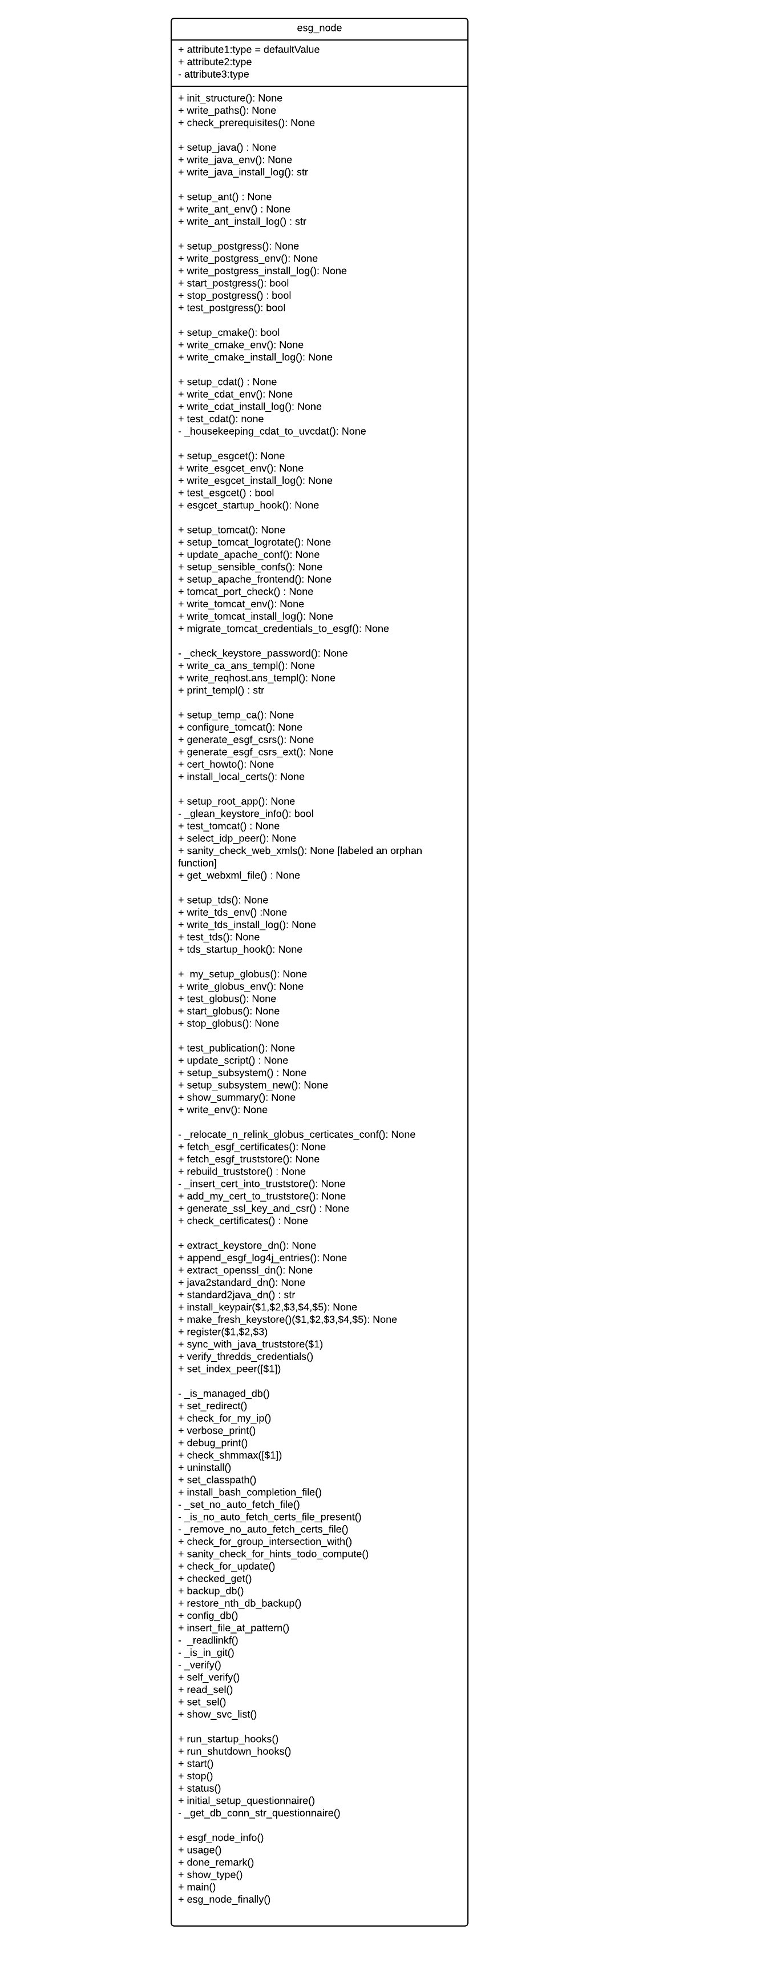
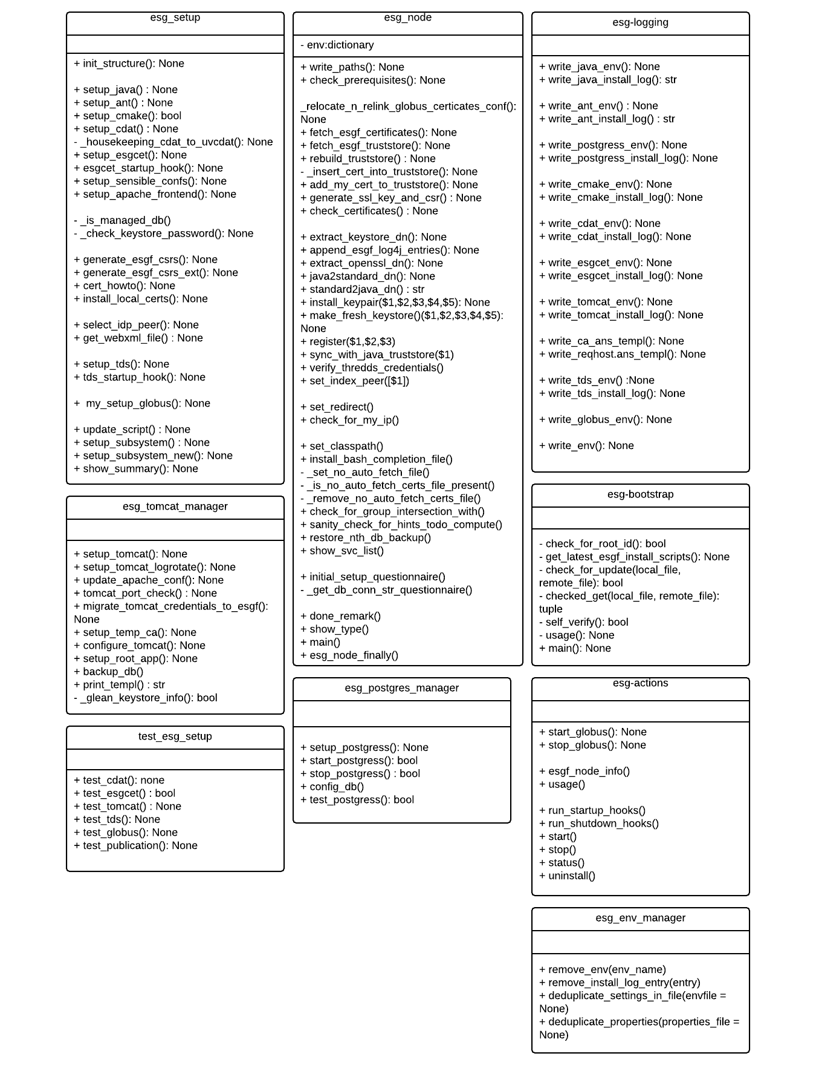
UML Diagram of Redesigned ESGF Installer

Slide 15
Pros and Cons
Pros
Cons
Better modifiability
Easier usability
Enhanced readability
Easier maintainability
Greater testability
Initial development time for the refactor
Would have to eventually upgrade to Python 3
Notes:
Better logging and error handling
Better alignment with the rest of the ESGF codebase
Better developer tooling
“The more readable a code is the more modifiable it is. Modifiability of a code goes down in proportion to its readability” [SW Arch in Python, Pillai]
Cohesion - refers to the degree to which the elements inside a module belong together [wikipedia]
Coupling - degree of interdependence between software modules; a measure of how closely connected two routines or modules are [wikipedia]
Coupling is usually contrasted with cohesion. Low coupling often correlates with high cohesion, and vice versa. Low coupling is often a sign of a well-structured computer system and a good design, and when combined with high cohesion, supports the general goals of high readability and maintainability

Slide 16
Current Status
Conversion of the codebase to Python is about 65% completed
More automated testing is needed
The current release (version 2.5) is scheduled to go into production in late May.
Work on a rudimentary UI began in May 2017

Slide 17
Future Work
Adding a continuous integration server to help ease deployments
Unit tests
User Interface (UI)
Easy installation;
This is allow it be opened up by the general public
Docker
Modularity
Python 3
Documentation
Streamline release process

Slide 18




Docker and Cloud Motivation
The current shell-based installer is monolithic, difficult to understand and upgrade, prone to error, does not allow different architectures, and cannot be used in a distributed environment – a new solution is needed!
The proposed Python-based installer will alleviate some of these problems (better language, modularity, more testable) but it will still not allow flexible deployments in distributed environments, and it will still require per-site compilation
It can be part of the solution, but can not define the high level installation design
The word is changing in response to Big Data needs and the Cloud:
Container technologies (e.g. Docker) make deploying and running applications much easier
Cloud providers enable provisioning and scaling resources on demand
Orchestration engines (such as Docker Compose, Docker Swarm, Amazon ECS, Kubernetes) enable connecting, deploying and scaling system of applications
The ESGF architecture must evolve as well to become more flexible, scalable, and testable… or become obsolete within a few years

Slide 19
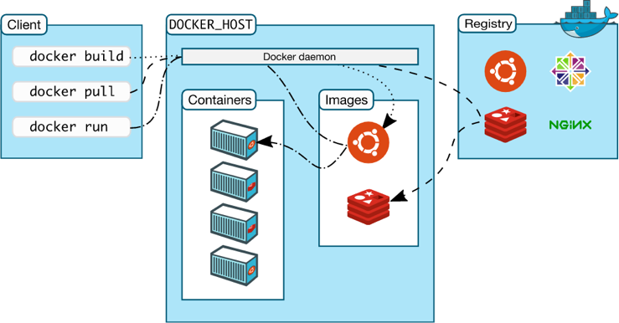
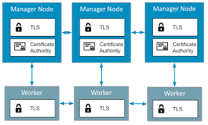
Docker Overview
Docker is the leading “containerization” technology: “build, ship and run”
Applications are built as software images that include the application itself, all required dependencies, and “just enough OS” to run them
Images are uploaded to web repositories (such as Docker Hub)
Images are deployed as “black boxes” on any platform running a Docker engine
Docker Compose and Docker Swarm enable deploying and scaling applications composed of multiple interacting containers, on a single host or multiple hosts

Slide 20

Using Docker for ESGF: pros and cons
Advantages:
Extreme simplification of installation process
No per-site compilation required: everybody runs exactly the same code, with the same dependencies, on the same OS
Easy upgrade of single images or the full stack, in response to new functionality or security threats
Enable upgrade rollbacks
Flexible deployment architectures: full node, index node, data node,…
Seamless deployment on laptops, in-premise cluster, Cloud
Easy scaling of resources for searching, data transfer, computing, …
Disadvantes:
Docker and the Cloud present a steep learning curve for system administrators: not “business as usual”, rather a new paradigm for building, deployoing, running and monitoring applications

Slide 21
Prototype ESGF Docker Architecture (1)
DREAM is supporting the design and prototyping of a next generation ESGF architecture based on Docker containers
The most important ESGF modules have been converted to Docker images
A full ESGF node can be configured and started with only a few commands, in a matter of minutes…
Multiple deployment configurations are available: full node, index node, data node
Prototype deployment on laptop, internal cluster, Amazon Cloud
Converted
Core ESGF node
Postgres
In progress
Node Manager
Dashboard
Not started
MyProxy
Globus
CoG
HTTPD w/ ESGF config
Tomcat w/ ESGF config
Solr
ESGF Search
ESGF ORP
TDS w/ ESGF config
ESGF IdP
ESGF Publisher client
ESGF Stats
ESGF Short Lived Certificate Server
LAS

Slide 22
Prototype ESGF Docker Architecture (2)

Slide 23

Docker & Cloud Proposed Work
With this proposal, we intend to leverage the DREAM research work to transition the ESGF operational system to be based on Docker, and optionally be deployed on the Cloud:
Co-fund the architecture design and migration of the current shell installer functionality to Docker
Possibly, use the new Python installer to build each Docker image, standalone
Development of data migration tools (Solr metadata, THREDDS catalogs, Postgres database, CoG site data, …)
Demonstration of new architecture for other BER science domains
Extensive documentation and training for ESGF node administrators, possibly code sprints and workshops
Estimated work: several FTEs across the federation to develop, test and operate the new infrastructure

